Slide 1
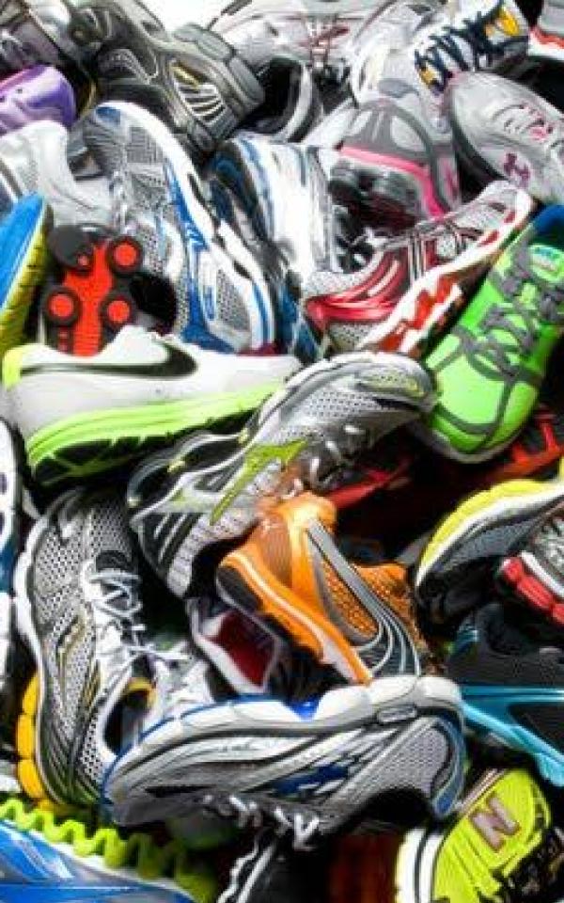
RECOMMENDER
RUNNINGSHOES
A DSI-9 CAPSTONE PROJECT BY AdriaN

Slide 2
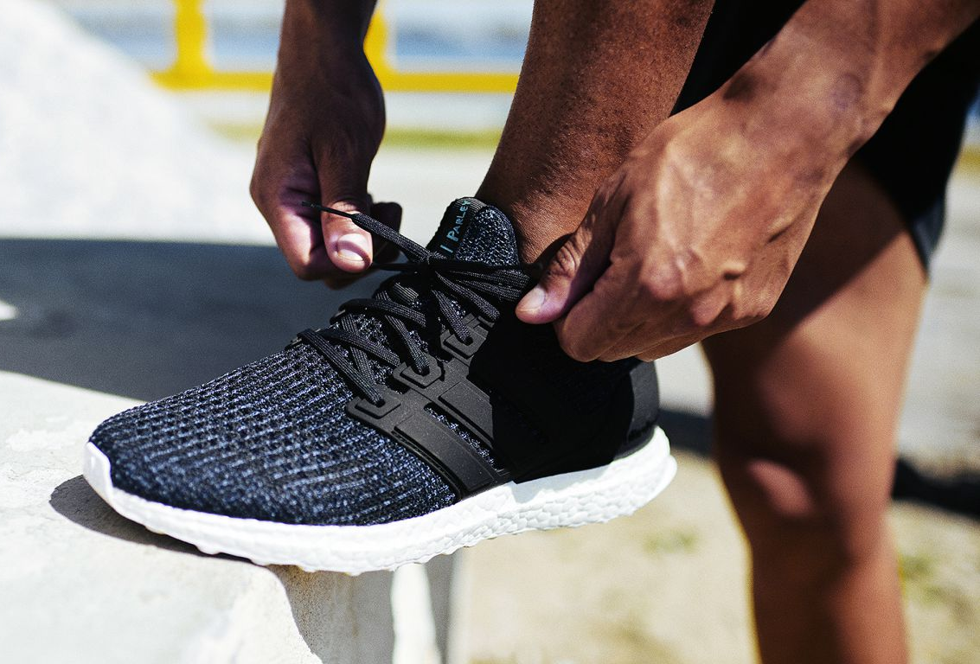
contents
Problem Statement Dataset Approach Results Benefits / Limitations Future Work

Slide 3

Problem statement
Why am I doing this?
Notes:
You have a favourite pair of running shoes – they are wearing out. You are looking for a new pair, and the choices are numerous. You could look up the latest models and user reviews online, or you could browse in-store and try out a few pairs, or both. But that is going to cost you time. You want the (almost) perfect pair, the one that is most worthwhile to invest on.

Slide 4
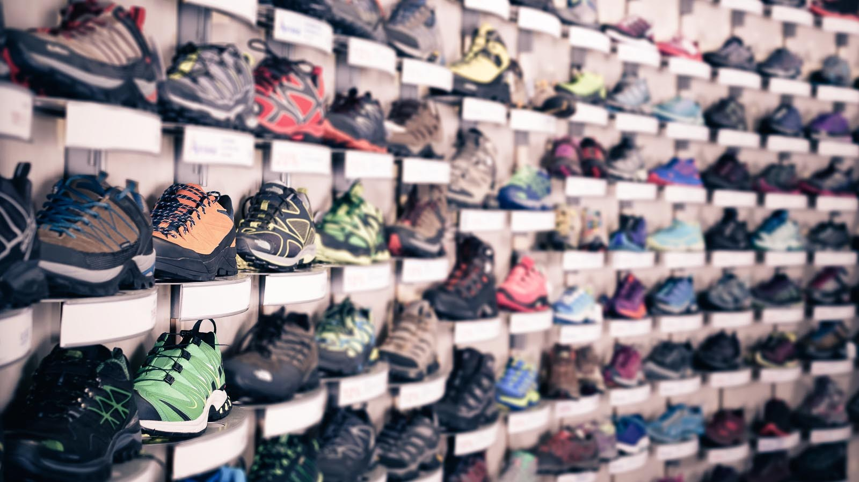
Recommend running shoes for individuals based on features of their favourite pair or personal preferences.
Notes:
You have a favourite pair of running shoes – they are wearing out. You are looking for a new pair, and the choices are numerous. You could look up the latest models and user reviews online, or you could browse in-store and try out a few pairs, or both. But that is going to cost you time. You want the (almost) perfect pair, the one that is most worthwhile to invest on.

Slide 5
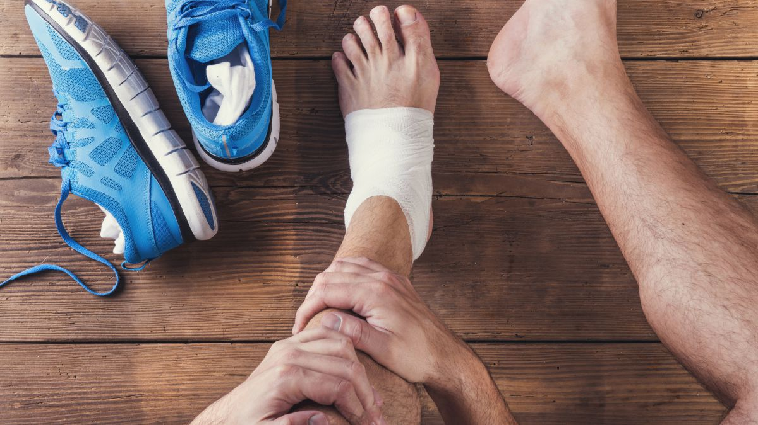
Recommend running shoes that fit well and provide the right support for each individual’s running style.
Notes:
Drawing from a rather unpleasant experience where I had made an ill-informed decision previously on getting running shoes that looked and felt good, but did not fit my running style. In the end, I got shin splints.

Slide 6
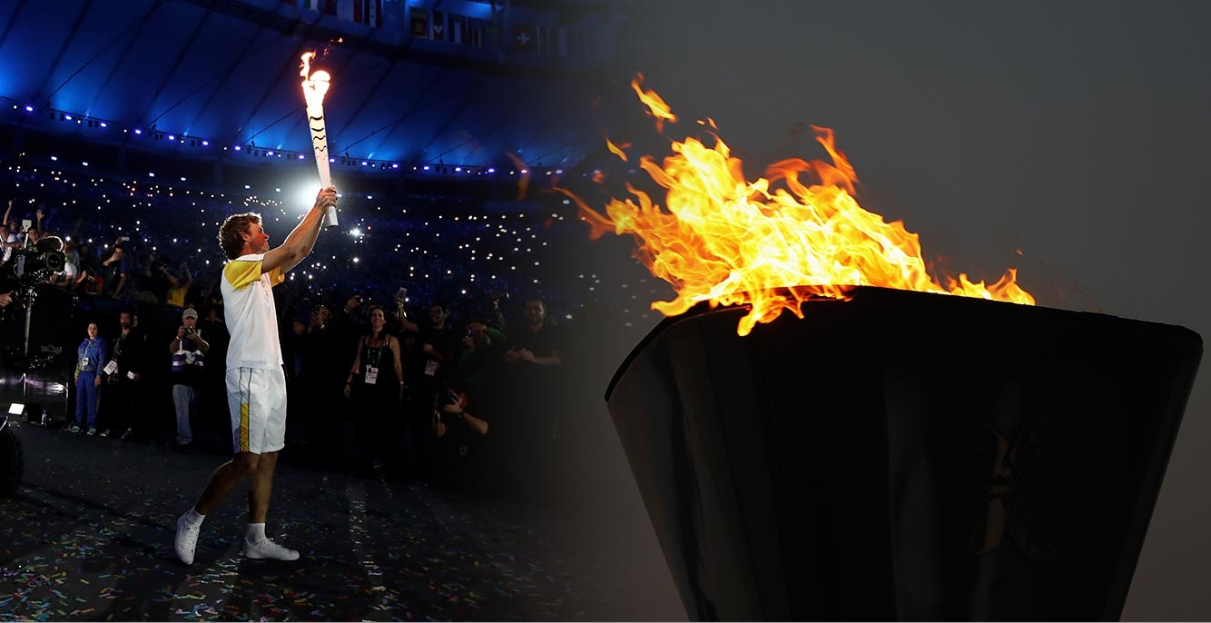
DATA PREPROCESSING
Everything has a beginning…

Slide 7
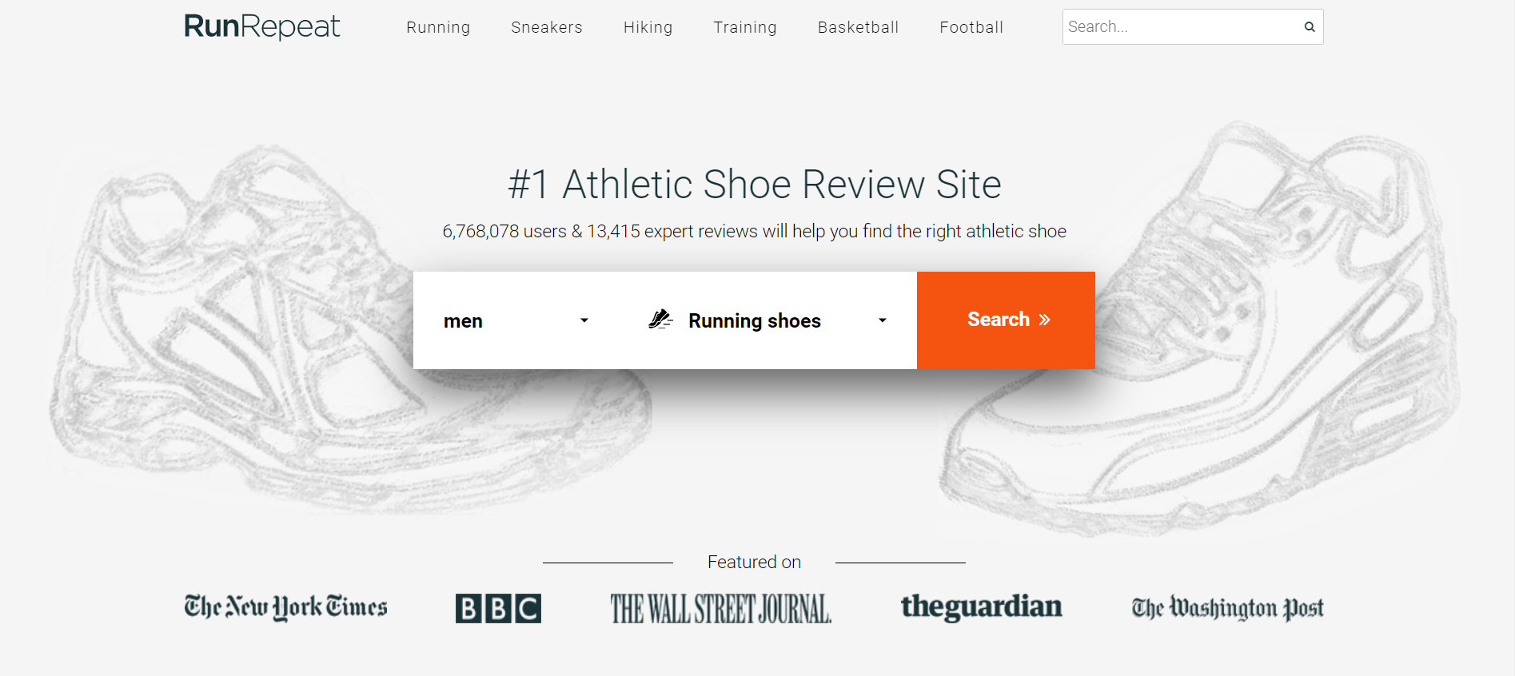
dATASET
Running shoes data scraped from RunRepeat
2,066 running shoes
35 features
8,191 reviews

Slide 8
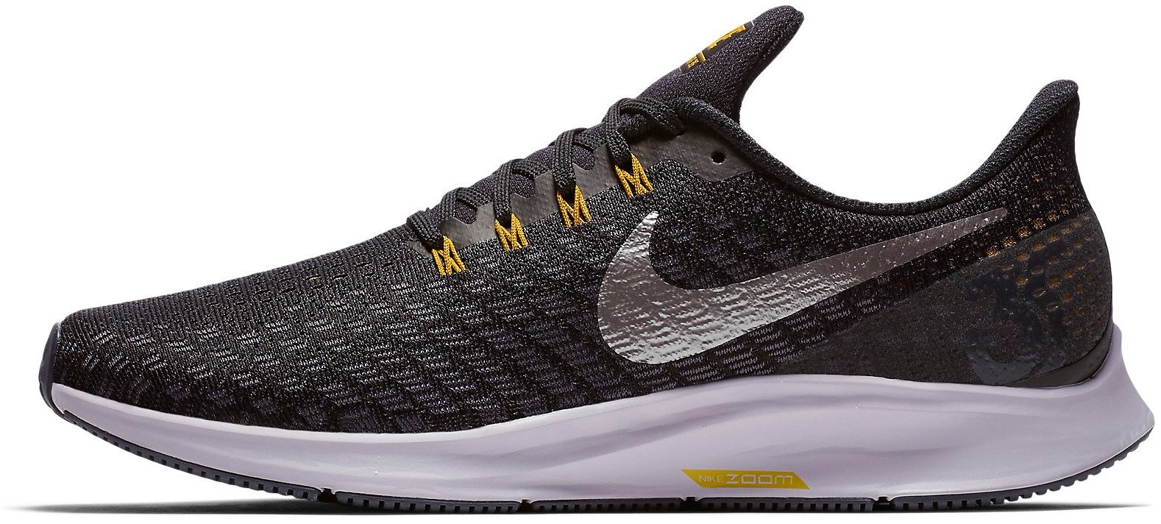
dATASET
Features
Brand
Terrain
Arch support
Use
Price
Weight
Heel-to-toe drop
Width
Ratings
Reviews
Sizing, fitting, upper, midsole, outsole

Slide 9

Approach
Content-based Filtering
User’s profile
Gender - Female
Brand - Salomon
Terrain - Road
Arch support - Neutral
Use - Daily running
Price – Low
Heel-to-toe drop - Low

Slide 10
Results
Most similar shoes to user’s profile
Salomon; Daily running; Road running; Neutral arch support; Low price range; Low heel-to-toe drop
Name | Brand | Use | Terrain | Arch support | Price | Weight | Heel-to-toe drop | Heel height | Forefoot height | Width
Wave Catalyst 2 | Mizuno | Daily running | Road | Neutral | 210 | 220 | 3 | 26 | 23 | Standard
Gel Flux 3 | Asics | Daily running | Road | Neutral | 190 | 269 | 4 | 24 | 20 | Standard
Cohesion 9 | Saucony | Daily running | Road | Neutral | 120 | 227 | 4 | 32 | 28 | Narrow, Standard
Air Zoom Elite 8 | Nike | Daily running | Road | Neutral | 220 | 244 | 3 | 13 | 10 | Standard, Wide
Wave Rider 20 | Mizuno | Daily running | Road | Neutral | 230 | 235 | 4 | 18 | 14 | Standard, Wide
Notes:
Did not recommend Salomon shoes at all due to strong similarity in features other than brand
Logically it is good to recommend shoes based on performance requirements instead of just the branding

Slide 11
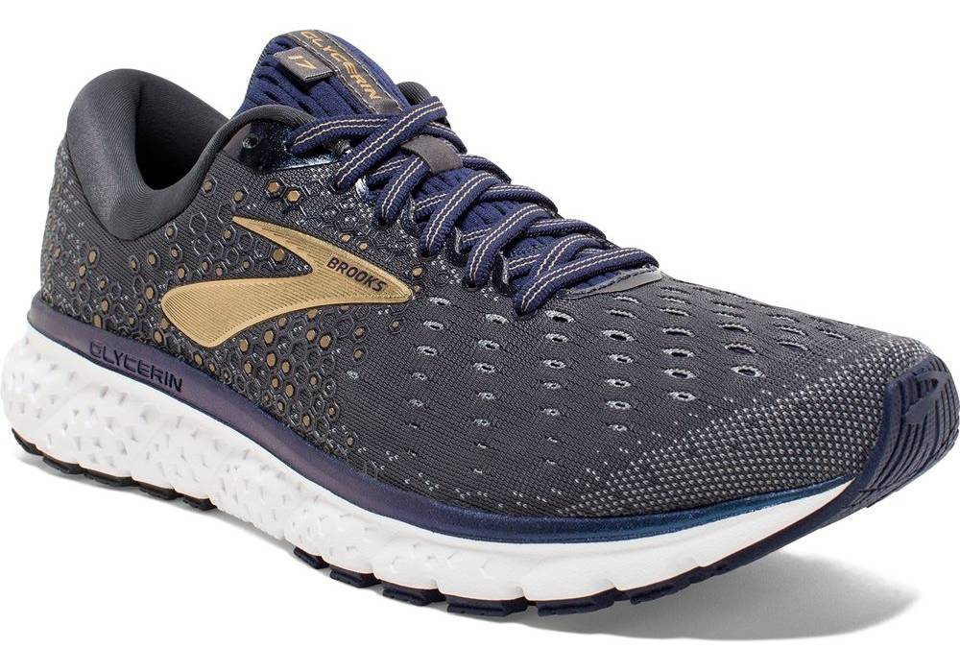
Approach
Content-based Filtering
User’s profile
Shoe features

Slide 12
Results
Most similar shoes to Brooks Glycerin 17
Name | Brand | Price | Weight | Heel-to-toe drop | Heel height | Forefoot height | Width
Glycerin 17 | Brooks | 290 | 300 | 10 | 32 | 22 | Standard, Wide
Glycerin 16 | Brooks | 290 | 301 | 10 | 32 | 22 | Standard, Wide
Fresh Foam 1080 v9 | New Balance | 290 | 294 | 8 | 30 | 22 | Narrow, Standard, Wide, Extra wide
Wave Ultima 9 | Mizuno | 270 | 305 | 8 | 30 | 22 | Standard
Glycerin 15 | Brooks | 290 | 300 | 10 | 30 | 20 | Standard
Triumph ISO 5 | Saucony | 310 | 323 | 10 | 32 | 22 | Standard
Common features: Daily, road running; Neutral arch support

Slide 13
Results
Most similar shoes to Brooks Glycerin 17
Status: In production
Name | Brand | Price | Weight | Heel-to-toe drop | Heel height | Forefoot height | Width
Glycerin 17 | Brooks | 290 | 300 | 10 | 32 | 22 | Standard, Wide
Fresh Foam 1080 v9 | New Balance | 290 | 294 | 8 | 30 | 22 | Narrow, Standard, Wide, Extra wide
Triumph ISO 5 | Saucony | 310 | 323 | 10 | 32 | 22 | Standard
33-M 2 | Asics | 270 | 314 | 10 | 30 | 20 | Standard
Ghost 12 | Brooks | 250 | 295 | 10 | 32 | 22 | Standard
Energy Boost 3 | Adidas | 310 | 309 | 5 | 29 | 24 | Standard, Wide
Common features: Daily, road running; Neutral arch support

Slide 14
Approach
Content-based Filtering
User’s profile
Shoe features
Ratings (quantity and score)
Reviews, textual descriptions

Slide 15
Results
Most similar shoes to Brooks Glycerin 17
Taking into account similarities in ratings, reviews and textual descriptions
Name | Brand | Price | Weight | Heel-to-toe drop | Heel height | Forefoot height | Width
Glycerin 17 | Brooks | 290 | 300 | 10 | 32 | 22 | Standard, Wide
Glycerin 16 | Brooks | 290 | 301 | 10 | 32 | 22 | Standard, Wide
Ghost 12 | Brooks | 250 | 295 | 10 | 32 | 22 | Standard
Ultraboost 19 | Adidas | 350 | 309 | 10 | 29 | 19 | Standard
Clifton 5 | Hoka One One | 250 | 266 | 5 | 30 | 25 | Standard, Wide
Sense Ride 2 | Salomon | 230 | 270 | 7 | 25 | 18 | Standard
Common features: Daily, road running; Neutral arch support

Slide 16
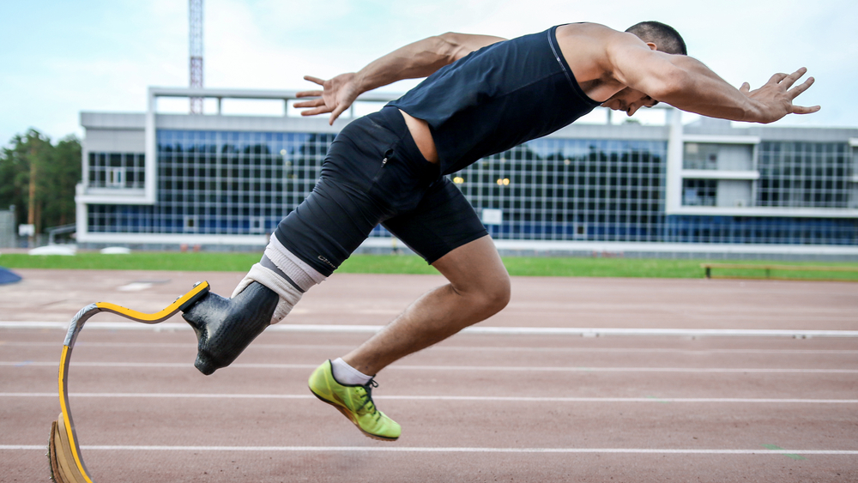
Benefits / LIMITATIONS
Gives personalised recommendations and does not need data about other users, hence highly scalable.
Able to capture specific needs of user and recommend niche items that other users might not be interested in.
Recommended shoe will almost always match up to the features of user’s profile/ existing pair - unable to expand on user’s existing interests.

Slide 17
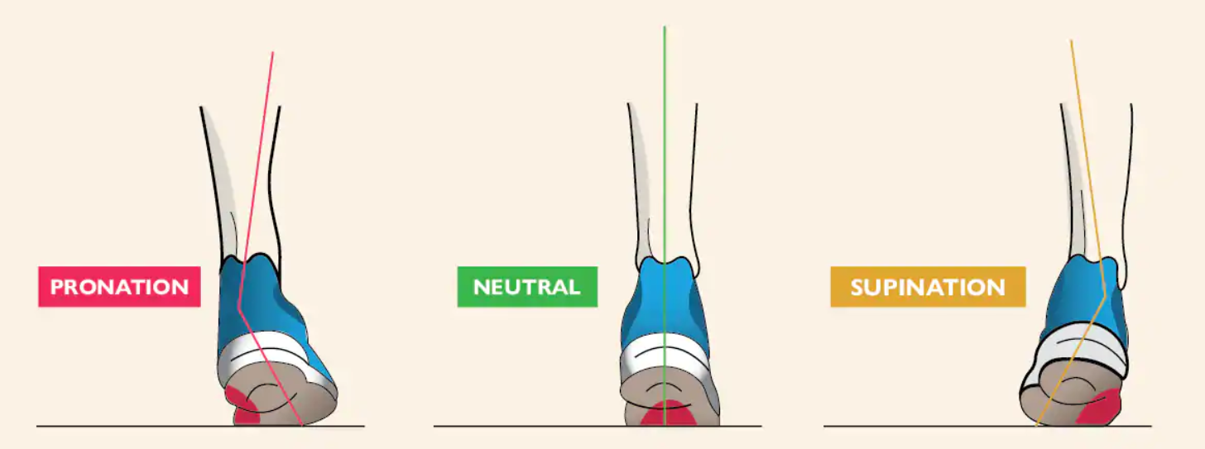
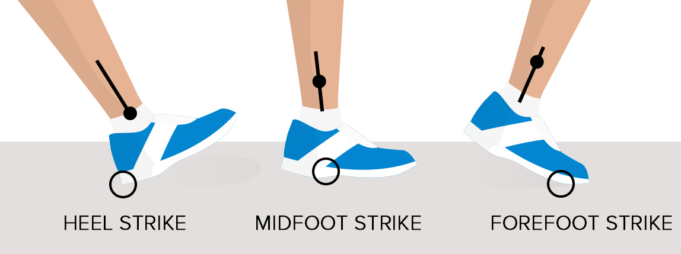
Future work
Hybrid recommendation system
Gather users’ data to recommend shoes liked by users of similar profiles, while meeting users’ individual needs
Deployment
Guide users to understand and choose correct features:
Arch support
Heel-to-toe drop
Motion control/ Stability
Neutral
Normal
Low to zero
Zero
Notes:
Competition - Fast but less cushioning and support
Flat feet → Motion control
Overpronation/ Low arch → Stability
Underpronation/ High arch → Neutral
Heel strikers → Normal drop
Midfoot strikers → Low to zero drop
Forefoot strikers → Zero heel-to-toe drop

Slide 18
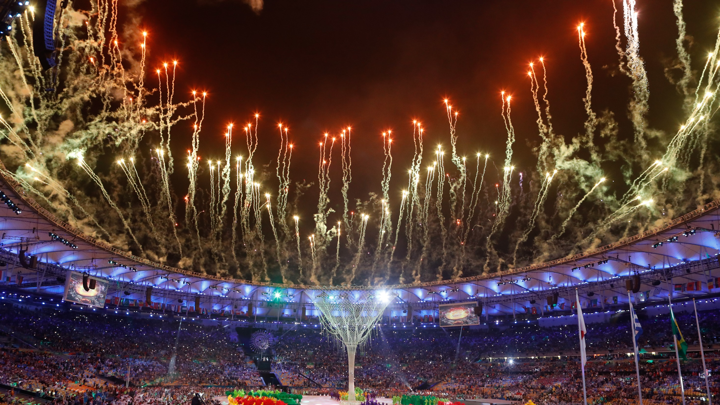
Thank you
… and an ending.

